Slide 1

How Excessive & Violent Media Harms Children and What We Can Do to Protect Them
Kristine Paulsen
kristinespaulsen@gmail.com
906 280 4115
www.TakeTheChallengeNow.net

Slide 2
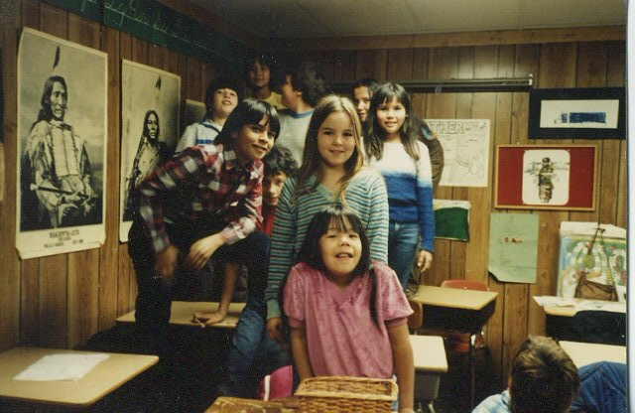

Slide 3
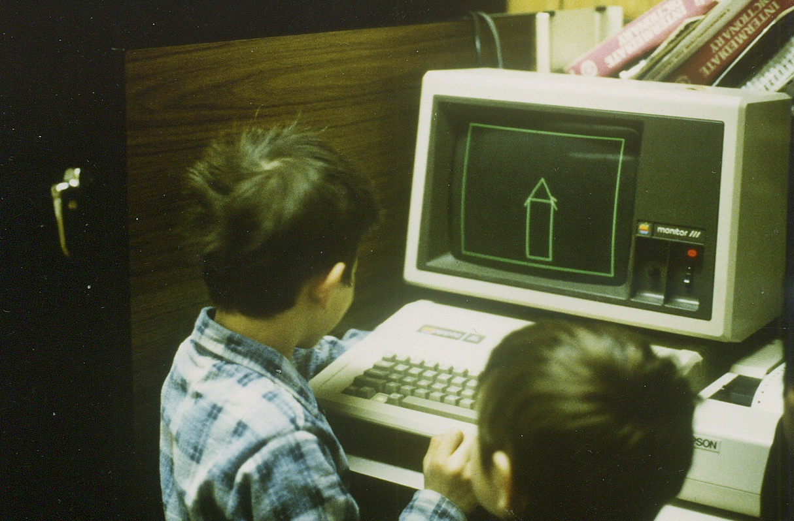

Slide 4


Slide 5
Problems and Solutions
Impact of Excessive & Violent Screen Time on:
Aggression and Bullying
Social and Emotional Health
Physical Health

Slide 6
Problems & Solutions
Dramatic change is possible.
Social Change is similar to an epidemic
An empowering vision by a small number of committed people can create epidemics of ideas that will change the world.
The Tipping Point by Malcolm Gladwell

Slide 7
Kaiser Foundation 2010 Survey of Entertainment Media Use - Ages 8 to 18
___ hours of TV a day
+ ___ hours of computers, video games & movies
= ___ TOTAL hours of screen time
___ time spent reading books.
Notes:
The problem is also the increasing amount of time spent watching screens.

Slide 8

38% of 8- to 10-year-old boys said they had played Grand Theft Auto
74% of 11- to 14-year-old boys said they had played Grand Theft Auto
(Kaiser Survey, 2010)

Slide 9

Impact of Violent Media on Aggression

Slide 10

  The American Medical Association
  The American Psychological Association
  The American Academy of Pediatrics
These three have looked at 50 years of research and agree that media violence is an important factor in the aggression we are seeing in our children today. Viewing entertainment violence can lead to increases in aggressive attitude and behavior.
The effects are measurable and long lasting.

Slide 11
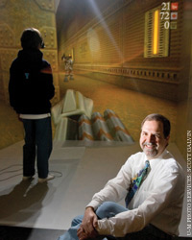
Repeated exposure to media violence is a stronger influence on aggressive behavior:
living in poverty
substance abuse
having abusive parents

Slide 12
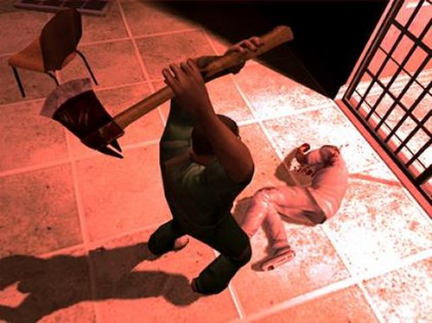

Slide 13


Slide 14
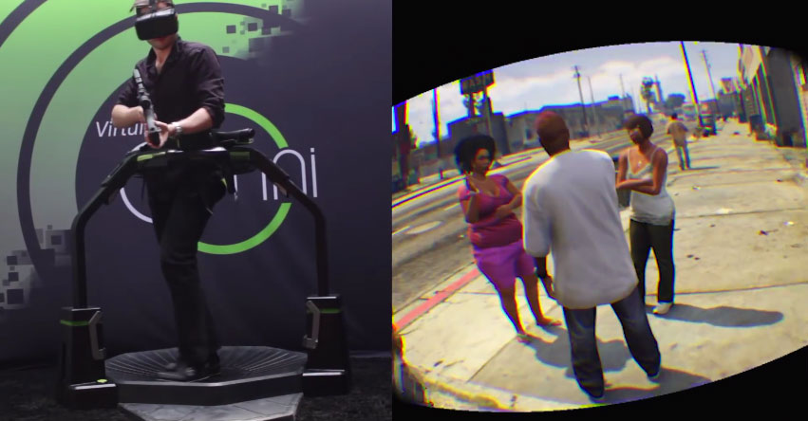

Slide 15
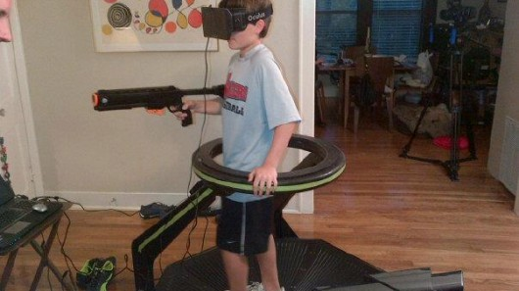

Slide 16
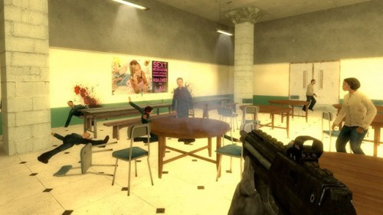
School Shooter: North American Tour

Slide 17
http://feministfrequency.com/2014/06/16/women-as-background-decoration-tropes-vs-women/

Slide 18
After Sandy Hook, the Entertainment Software Association released a statement:

Slide 19
The American Psychological Association (APA)
Statement on Violent Video Games, 2015
The link between violent video game exposure and aggressive behavior is one of the most studied and best established.

Slide 20
The APA found that:
Research has demonstrated an association between violent video game use and increases in aggressive behavior, aggressive affect, aggressive cognitions and. . .
decreases in prosocial behavior, empathy, and moral engagement;

Slide 21
Supreme Court Video Game Ruling
Brown v. Entertainment Merchants Association,
June 27, 2011

Slide 22
“What sense does it make to forbid selling to a 13-year-old boy a magazine with an image of a nude woman, while protecting a sale to that 13-year- old of an interactive video game in which he actively, but virtually, binds and gags the woman, then tortures and kills her?”
—U.S. Supreme Court Justice Steven Breyer Dissenting Opinion, Brown v. Entertainment Merchants Association, June 27, 2011

Slide 23
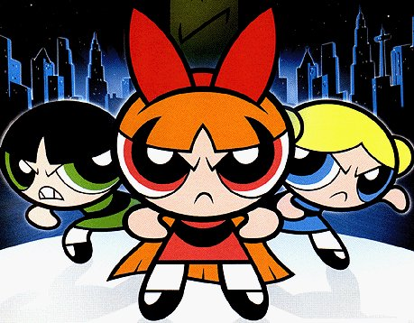
The average American child sees 200,000 violent acts on TV by age 18.
Powerpuff Girls - Watch our kindergarten crime fighters kick major villain butt!

Slide 24

Effects of “The Might Morphin Power Rangers” on Children’s Aggression with Peers

Slide 25
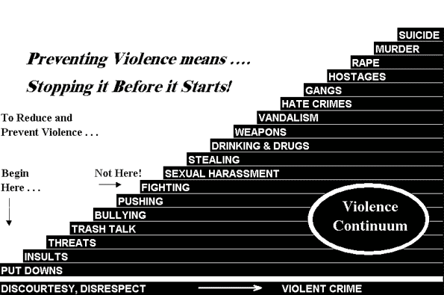

Slide 26
Indicators of School Crime and Safety
In 2014, there were 486,400 nonfatal violent victimizations at school among students 12 to 18 years of age.

Slide 27



Carl Joseph Walker-Hoover
Eric Mohat
Jaheem Herrera
Constantly bullied, he ends his life at age 11
Teen Commits Suicide Due to Bullying: Parents Sue School for Son's Death
My bullied son's last day on Earth
Slide prepared by Jim Vetter
Notes:
In just the past 2 months, you may have seen news reports about these young people taking their own lives and about the constant bullying that may have led to their deaths. Carl Joseph Walker-Hoover from Springfield, MA was less than 2 weeks away from his 12th birthday when his mother, who was preparing dinner, found him hanging from the railing of the third-floor landing, by an electrical cord. He left a note, saying he loved his mother and his aunt. And he also left his Pokemon games and cards to his 6-year-old brother. His mother believes that the unrelenting taunting and bullying he received at school led him to it.
This is one factors that ties aggression and suicide. We have increasing recognized the idea of “bullycide”—the stress of continual harrassment and isolation, and the feeling that no one (peers or adults) will stick up for them can lead some vulnerable young people to suicide.
Administrators are now paying additional attention, as parents like Eric Mohat’s are starting to sue schools for failing to intervene and put effective bullying prevention programs into place.
Youth violence can have a huge impact on many people’s lives. So, what can we do about it?

Slide 28
The Josephson Institute of Ethics surveyed 43,321 teenagers (2010)
47% said they had been “bullied, teased, or taunted in a way that seriously upset them.”
50% said they had “bullied, teased, or taunted someone at least once.”

Slide 29
Impact of Media on Mental Health
• Children who spent > 2 hours day watching TV or other screens were at increased risk of high levels of psychological difficulties
• Teens who spend long hours watching TV/screens are at higher risk for depression as adults

Slide 30
1 out of 10 video gamers develop a pathological addiction
Defined as damage to actual functioning -- their school, social, family, occupational, psychological functioning, etc.
To be considered pathological, gamers must be damaging multiple areas of their lives.
Pediatrics, 2011

Slide 31
A study in the journal Pediatrics notes
“Youth who became pathological gamers ended up with increased levels of depression, anxiety, and social phobia.”

Slide 32

The most addictive video games are Massively Multiplayer Online Role-Playing Games
World of Warcraft has 10 million subscribers who pay $15 a month (1.8 Billion a year)

Slide 33
A study published in the journal Suicide and Life-Threatening Behavior reported:
“Teens who reported 5 hours or more of video games/Internet daily use, in the 2009 Youth Risk Behavior Survey (YRBS), had a significantly higher risk for sadness, suicidal ideation, and suicide planning.

Slide 34
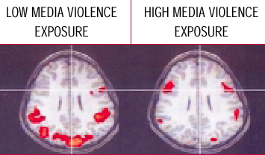
Indiana Medical School MRI Study
Aggressive Behavior Disorder

Slide 35
Aggressive Behavior Disorder

Slide 36
“Why wasn’t the public aware of the research?”
The CNN reporter asked Dr. Anderson, Iowa State professor and director of the Research Center on Violence, after the Sandy Hook massacre.

Slide 37
Consolidation of Media
In the 1980’s the number of broadcast stations were greatly reduced allowing media to be controlled by fewer and more powerful companies.
The Telecommunications Act of 1996 allowed multi media conglomerants.
This consolidation of media ownership has led to six huge media conglomerates.

Slide 38
Time Warner is the Largest conglomerate in the world, with holdings including:
CNN, a joint venture with CBS, HBO, Cinemax, Cartoon Network, TBS, TNT, America Online, MapQuest, Moviefone, Warner Bros. Pictures, and more than 150 magazines including Time, Sports Illustrated, Fortune, Marie Claire and People and in 2009 had revenues of 29 Billion.

Slide 39
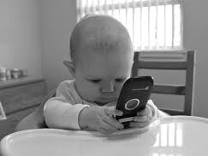
Impact of Excessive Media on Learning
Such early cellphone use is all the more dangerous because digital technology does not just consume attention; it also shapes the brain.
Your Brain on Screens, Dr. Richard Cytowic

Slide 40
Exposure to TV Violence Relate to Irregular Attention and Brain Structure, 2014
“We found that the more violent TV viewing a participant reported, the worse they performed on tasks of attention and cognitive control. . .
Violent TV impacted these subjects’ broad ability to make plans and decisions, reason and problem-solve, regulate attention, and inhibit behavior in order to achieve goals. They were more impulsive as well.

Slide 41

Excessive Media & Physical Health
The University of Buffalo, New York, conducted a study called Couch Potato Kids.
3 weeks collected data on exercise, eating, TV
3 weeks increased TV from baseline by 50%
3 weeks decreased TV from baseline by 50%

Slide 42
Research Summaries
TV viewing increases intake of high-density foods
Watching TV for an average of six hours a day could shorten the viewer's life expectancy by almost five years
Television Viewing increases Risk of Type 2 Diabetes and Cardiovascular Disease

Slide 43
The Solution: Strategies for Change

Slide 44

Student Media Awareness to Reduce Television (S.M.A.R.T.)
The Stanford University Prevention Research Center developed the S.M.A.R.T. curriculum for 3rd grade students to reduce the negative effects of excessive TV, video and video game use.

Slide 45
In randomized controlled trials the S.M.A.R.T. curriculum was proven to:
Reduce children’s TV, videos & video game use
Reduce obesity and weight gain
Reduce aggression in class and on playground
Reduce children’s requests for toys advertised on TV

Slide 46

Campaign for a Commercial-Free Childhood
Screen Free Week Resources
Other media education resources including:

Slide 47

Teachers and consultants in Northern Michigan developed Take the Challenge, a preschool – High School program, inspired by the SMART curriculum & other media education resources.
The program also includes reading, writing, math and technology activities. Lessons are aligned to the new Common Core Standards.
Notes:
We believed that involving an entire school would have more of an impact on children and families than just third or fourth grade. We also wanted to include more reading, writing, math and science connections.

Slide 48
Effects of Media Reduction On Playground Aggression
Average of Eight Schools

Slide 49
Effects of Media Reduction On Negative Classroom Behavior
K-6th Grade
Notes:
We also collected data on classroom behavior and saw negative behaviors cut in half.

Slide 50
Harvard Research Center for Media & Child Health Evaluation
Decreased media entertainment
Increased physical activity and sleep
More time talking with parents
Teachers reported greater work completion
Teachers reported more attentive and on task
Teachers reported students more respectful & less aggressive.

Slide 51
So what is the program?
1: Goal Setting
2: Data Collection – Daily Activities & Screen Habits
3: Exploration and Research
4: Develop New Media Habits! 1 + 3
5: Educate Others
Notes:
At the elementary level, there are approximately 15 lessons divided into six areas. The program is flexible and can be implemented in 1 to 5 weeks depending on how much time is available.

Slide 52
1. Goal Setting: What are Your Dreams and How Will You Reach Them?
LESSON 1: Goal Setting
Tell students: There are differences between dreams and goals. You may dream of becoming a ballerina but unless you work hard at dance class, practice every day, and listen to your instructor you will never reach your goal of becoming a ballerina.
Ask Students: Everybody has dreams; what are some of your dreams?
Notes:
This is a first grade lesson that helps students identify their dreams and will set the stage for lessons that help students see the impact that excessive media can have on their goals and dreams.

Slide 53
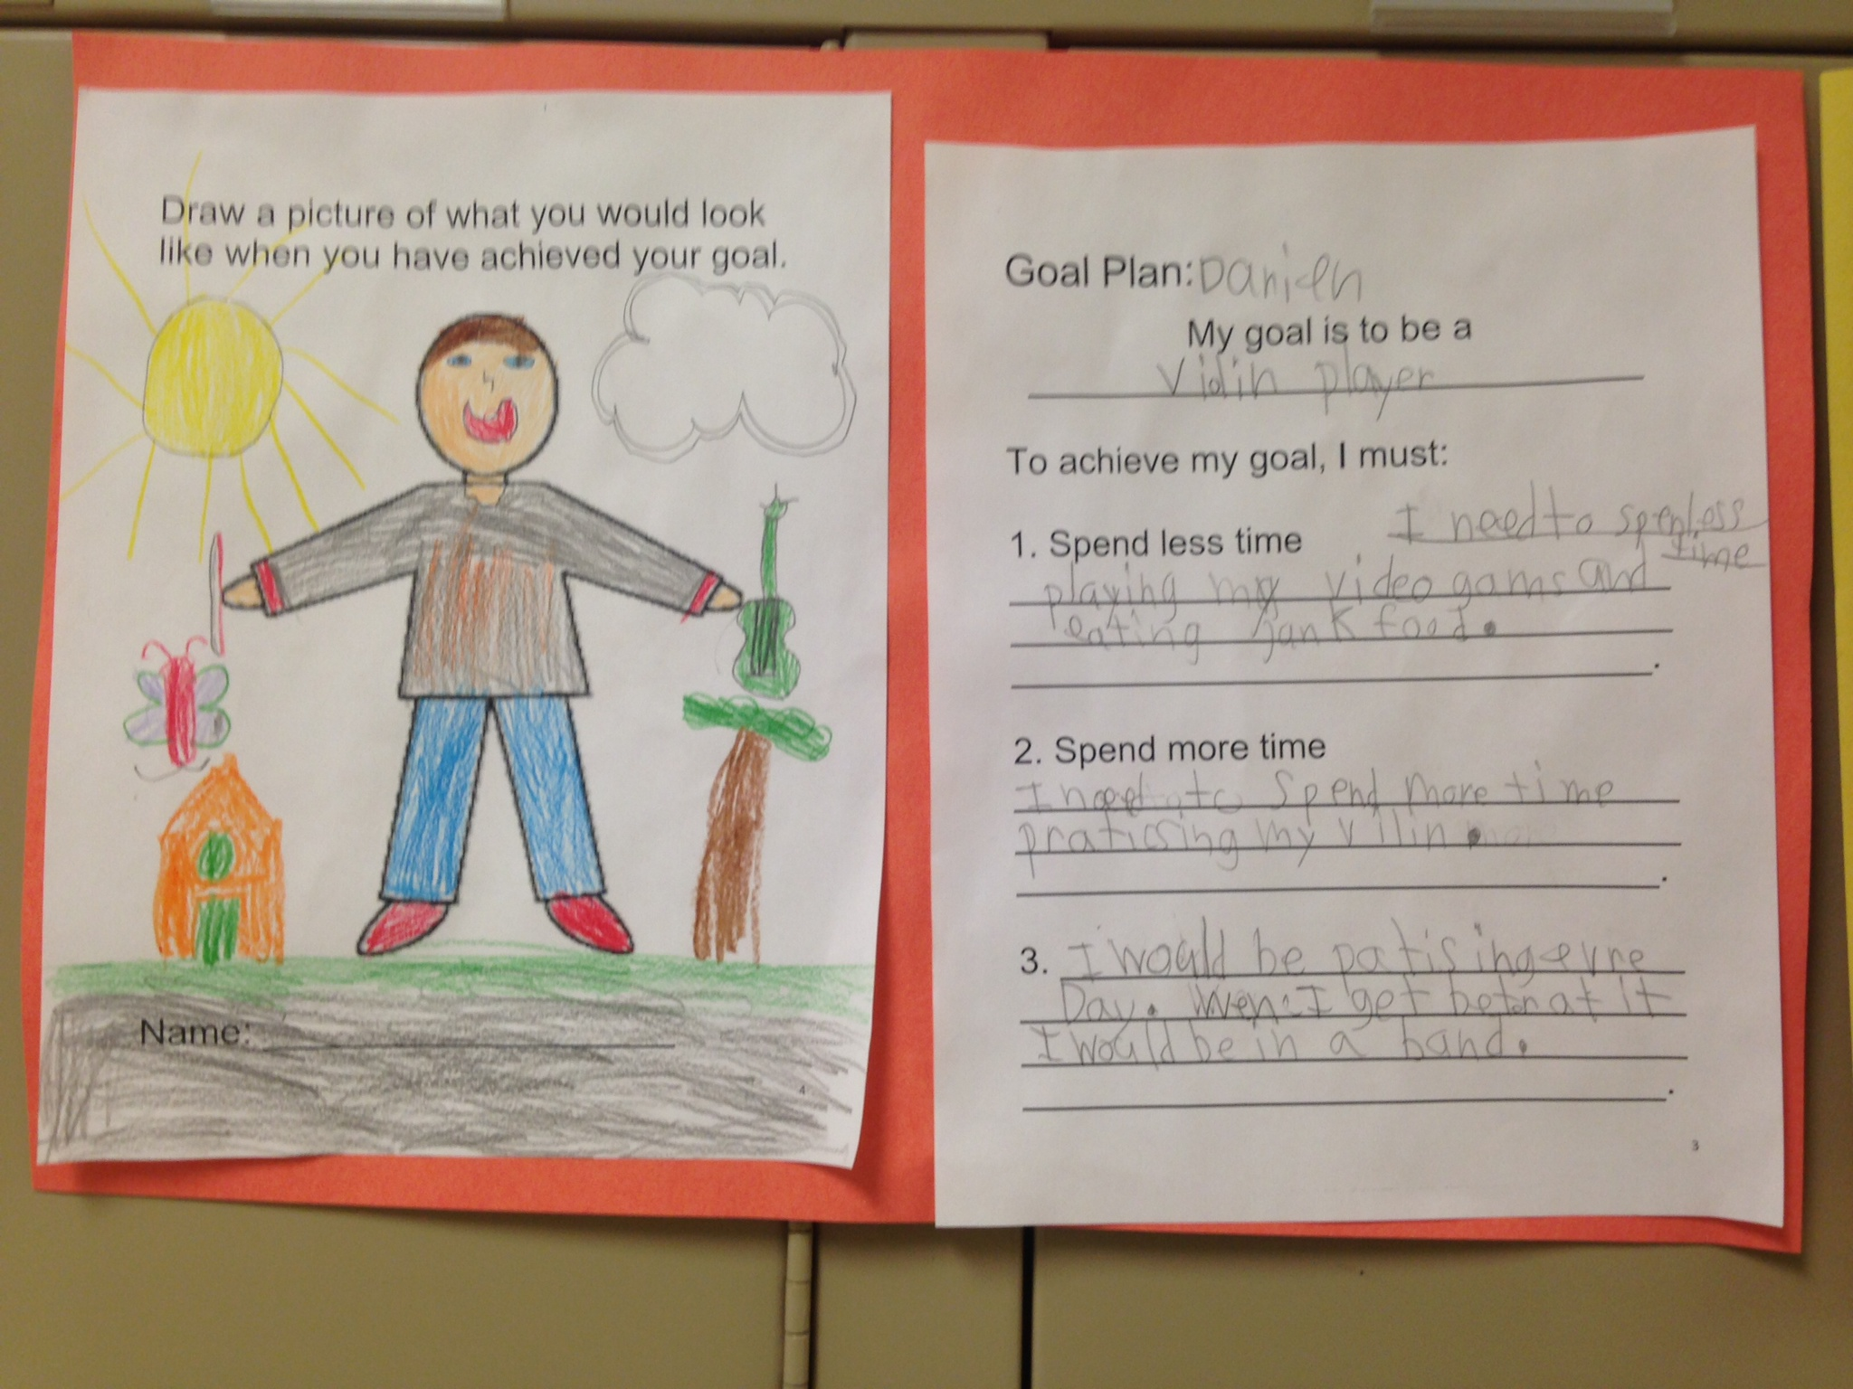
2nd Grade Lesson

Slide 54
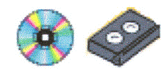
2. Data Collection – Daily Activities
Which screens did you use today? Circle One |  |  | How long?
Total Time Today? Add Hours:
Notes:
This is also a first grade lesson where students keep a 3 day screen log to become aware of how much time they spend watching screens. Parents are often very surprised!

Slide 55
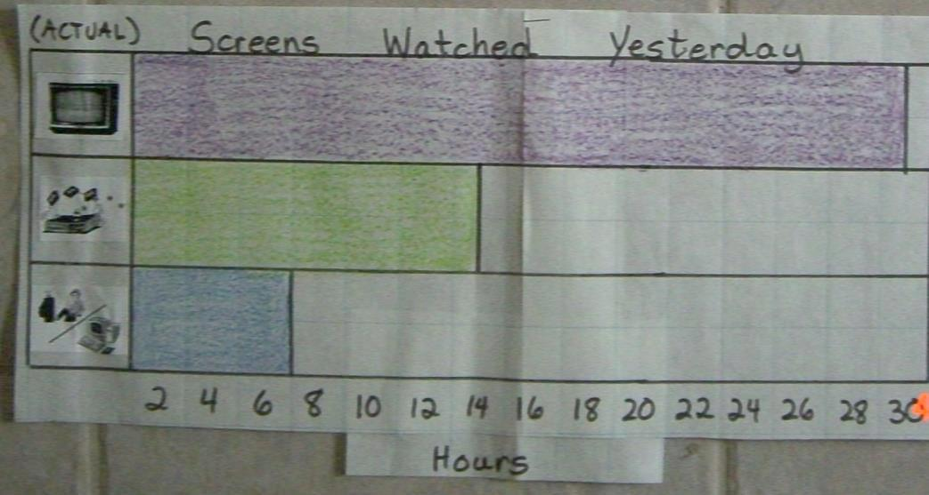
Children graph the class average.

Slide 56
High School students compare their media entertainment to the National Average
MEDIA ENTERTAINMENT USE
 | 1 | 2 | 3 | 4 | 5
 | Predict National Use | Your Media Yesterday | Total Class Time | Class Average | National Results
TV
Computer Don’t include computers for school work
Video Games
Movies
TOTAL Screen Use
Notes:
This middle school lesson has students predict the National Average for Screen Use first and then create graphs comparing their use, the classroom average and the National Average.

Slide 57

3: Exploration and Research
Notes:
The curriculum includes books we have written. This book is about what happens when you watch too much TV.

Slide 58
Notes:
The book includes a story about Rose as well as research related to the story in the shaded box. Rose no longer wants to eat the good food her father cooks. Instead she wants to eat junk food. The shaded box provides information from a research article. $46 billion dollars was spent on advertising in one year.

Slide 59
LESSON 3: Reading Research Articles: Students read research articles and learn to take notes.
TITLE & REFERENCE
INFORMATION If a direct quote use Quotation Marks
INFORMATION If a direct quote use Quotation Marks
DATA
SUMMARY
Notes:
Older students read research from Science Journals

Slide 60
Preschool Students Learn the TV Song (Tune is Frere Jacques – Verse 1)
If you watch TV all day long All day long, all day long You won’t be as HEALTHY You won’t be as FRIENDLY Or as SMART, or as SMART HEALTHY FRIENDLY | V fingers to eyes arm across/arm up make muscle man arms fingers wiggle past cheeks hand to forehead-outward SMART
Notes:
Even very young children can learn about the effects of too much TV and other screens.

Slide 61
Students Conduct Research
Violence in Cartoons Chart
Action | TALLY MARKS | NUMBER
HIT
KICK
PUNCH
BULLY
Notes:
Children in second grade watch 3 minutes of a cartoon meant for children and keep track of how many times the characters hit, push, or bully other characters.

Slide 62
Dear ___________________,
Today we watched _______________________. While we watched the show, we looked for _____________________________________.
I was ____________________. We found that ___________________________________________________________________________________________.
I plan to think carefully about what I watch on TV! I hope you do to!
Sincerely,
________________
Notes:
Students write letters home to their parents about what they have learned.

Slide 63

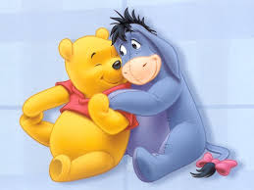
In high school students compare different kinds of cartoons and collect data on physical aggression and social aggression.

Slide 64
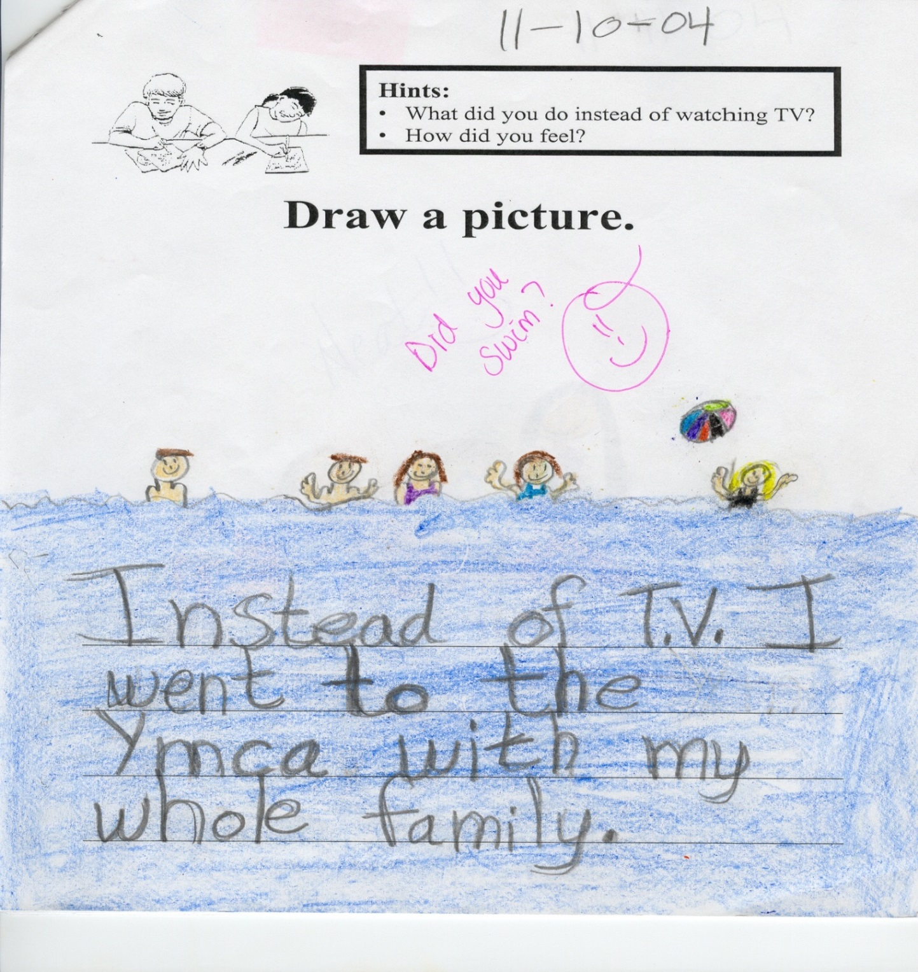
4: Develop New Media Habits! 1 + 3
Notes:
The curriculum leads up to a one week screen free followed by 3 weeks where students try to keep their screens to 10 hours a week.

Slide 65

After participating in the Screen-Free Challenge, students learn how to create a budget for weekly screen use.
10 Hour Screen Budget for Week # ___________

Slide 66
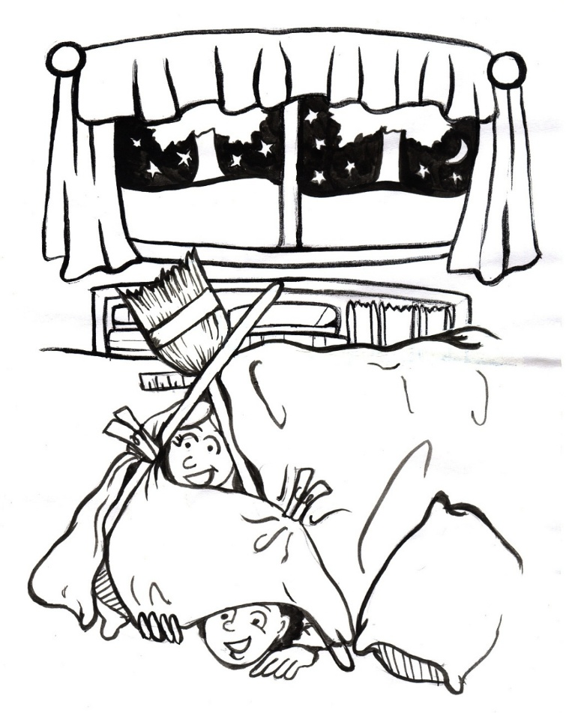
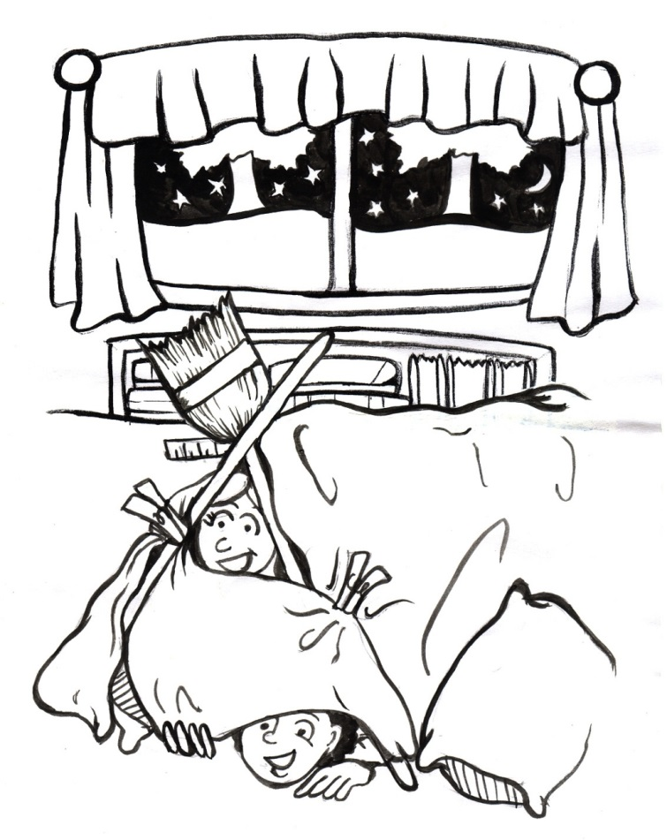
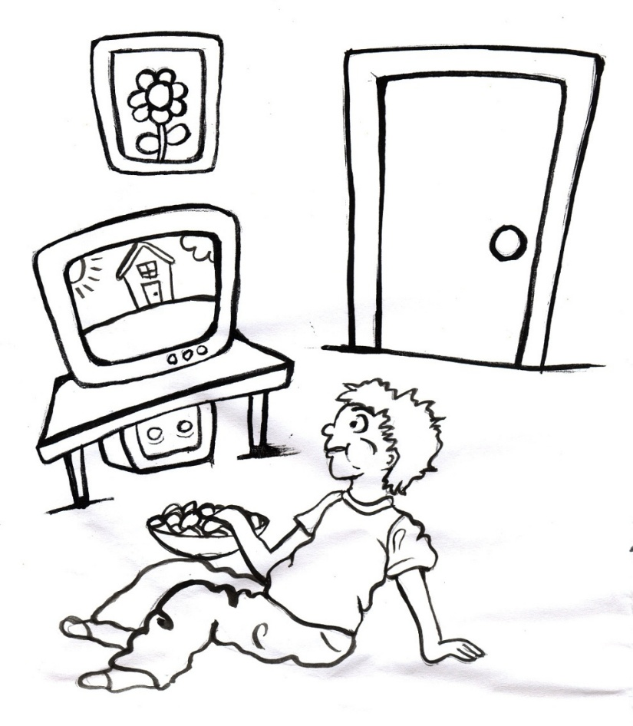
No Screens for Me
Or, I could make a fort!
I can spend my time watching TV.
Notes:
Students brainstorm and read about other activities besides watching screens.

Slide 67
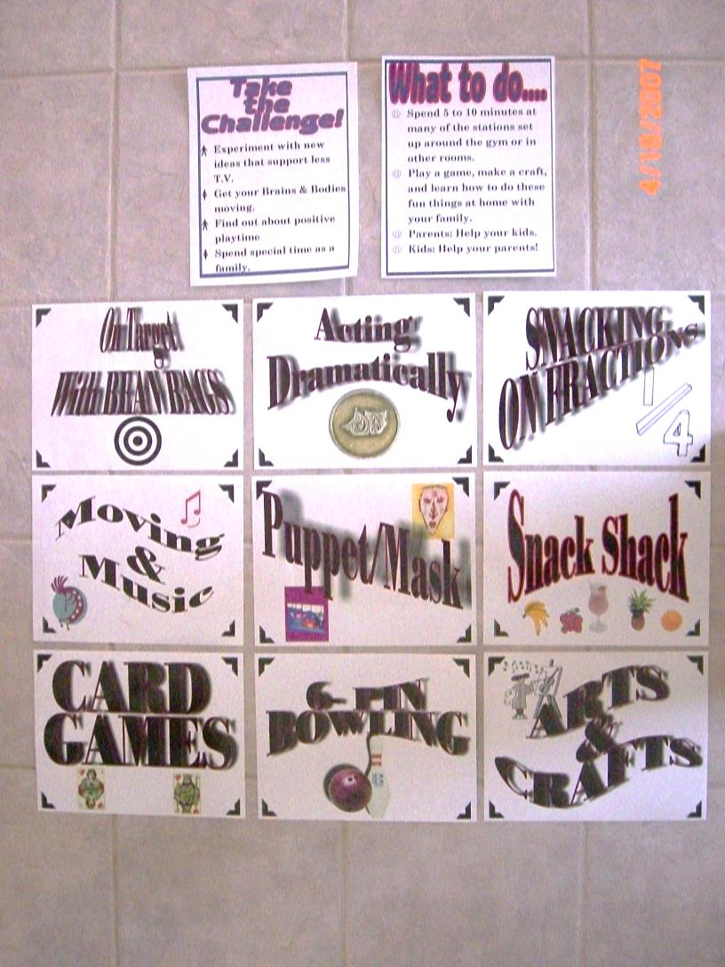
FAMILY
FUN
NIGHT
Notes:
Because children don’t always know what to do instead of watching TV the schools and Parent Groups organize Family Fun Nights.

Slide 68
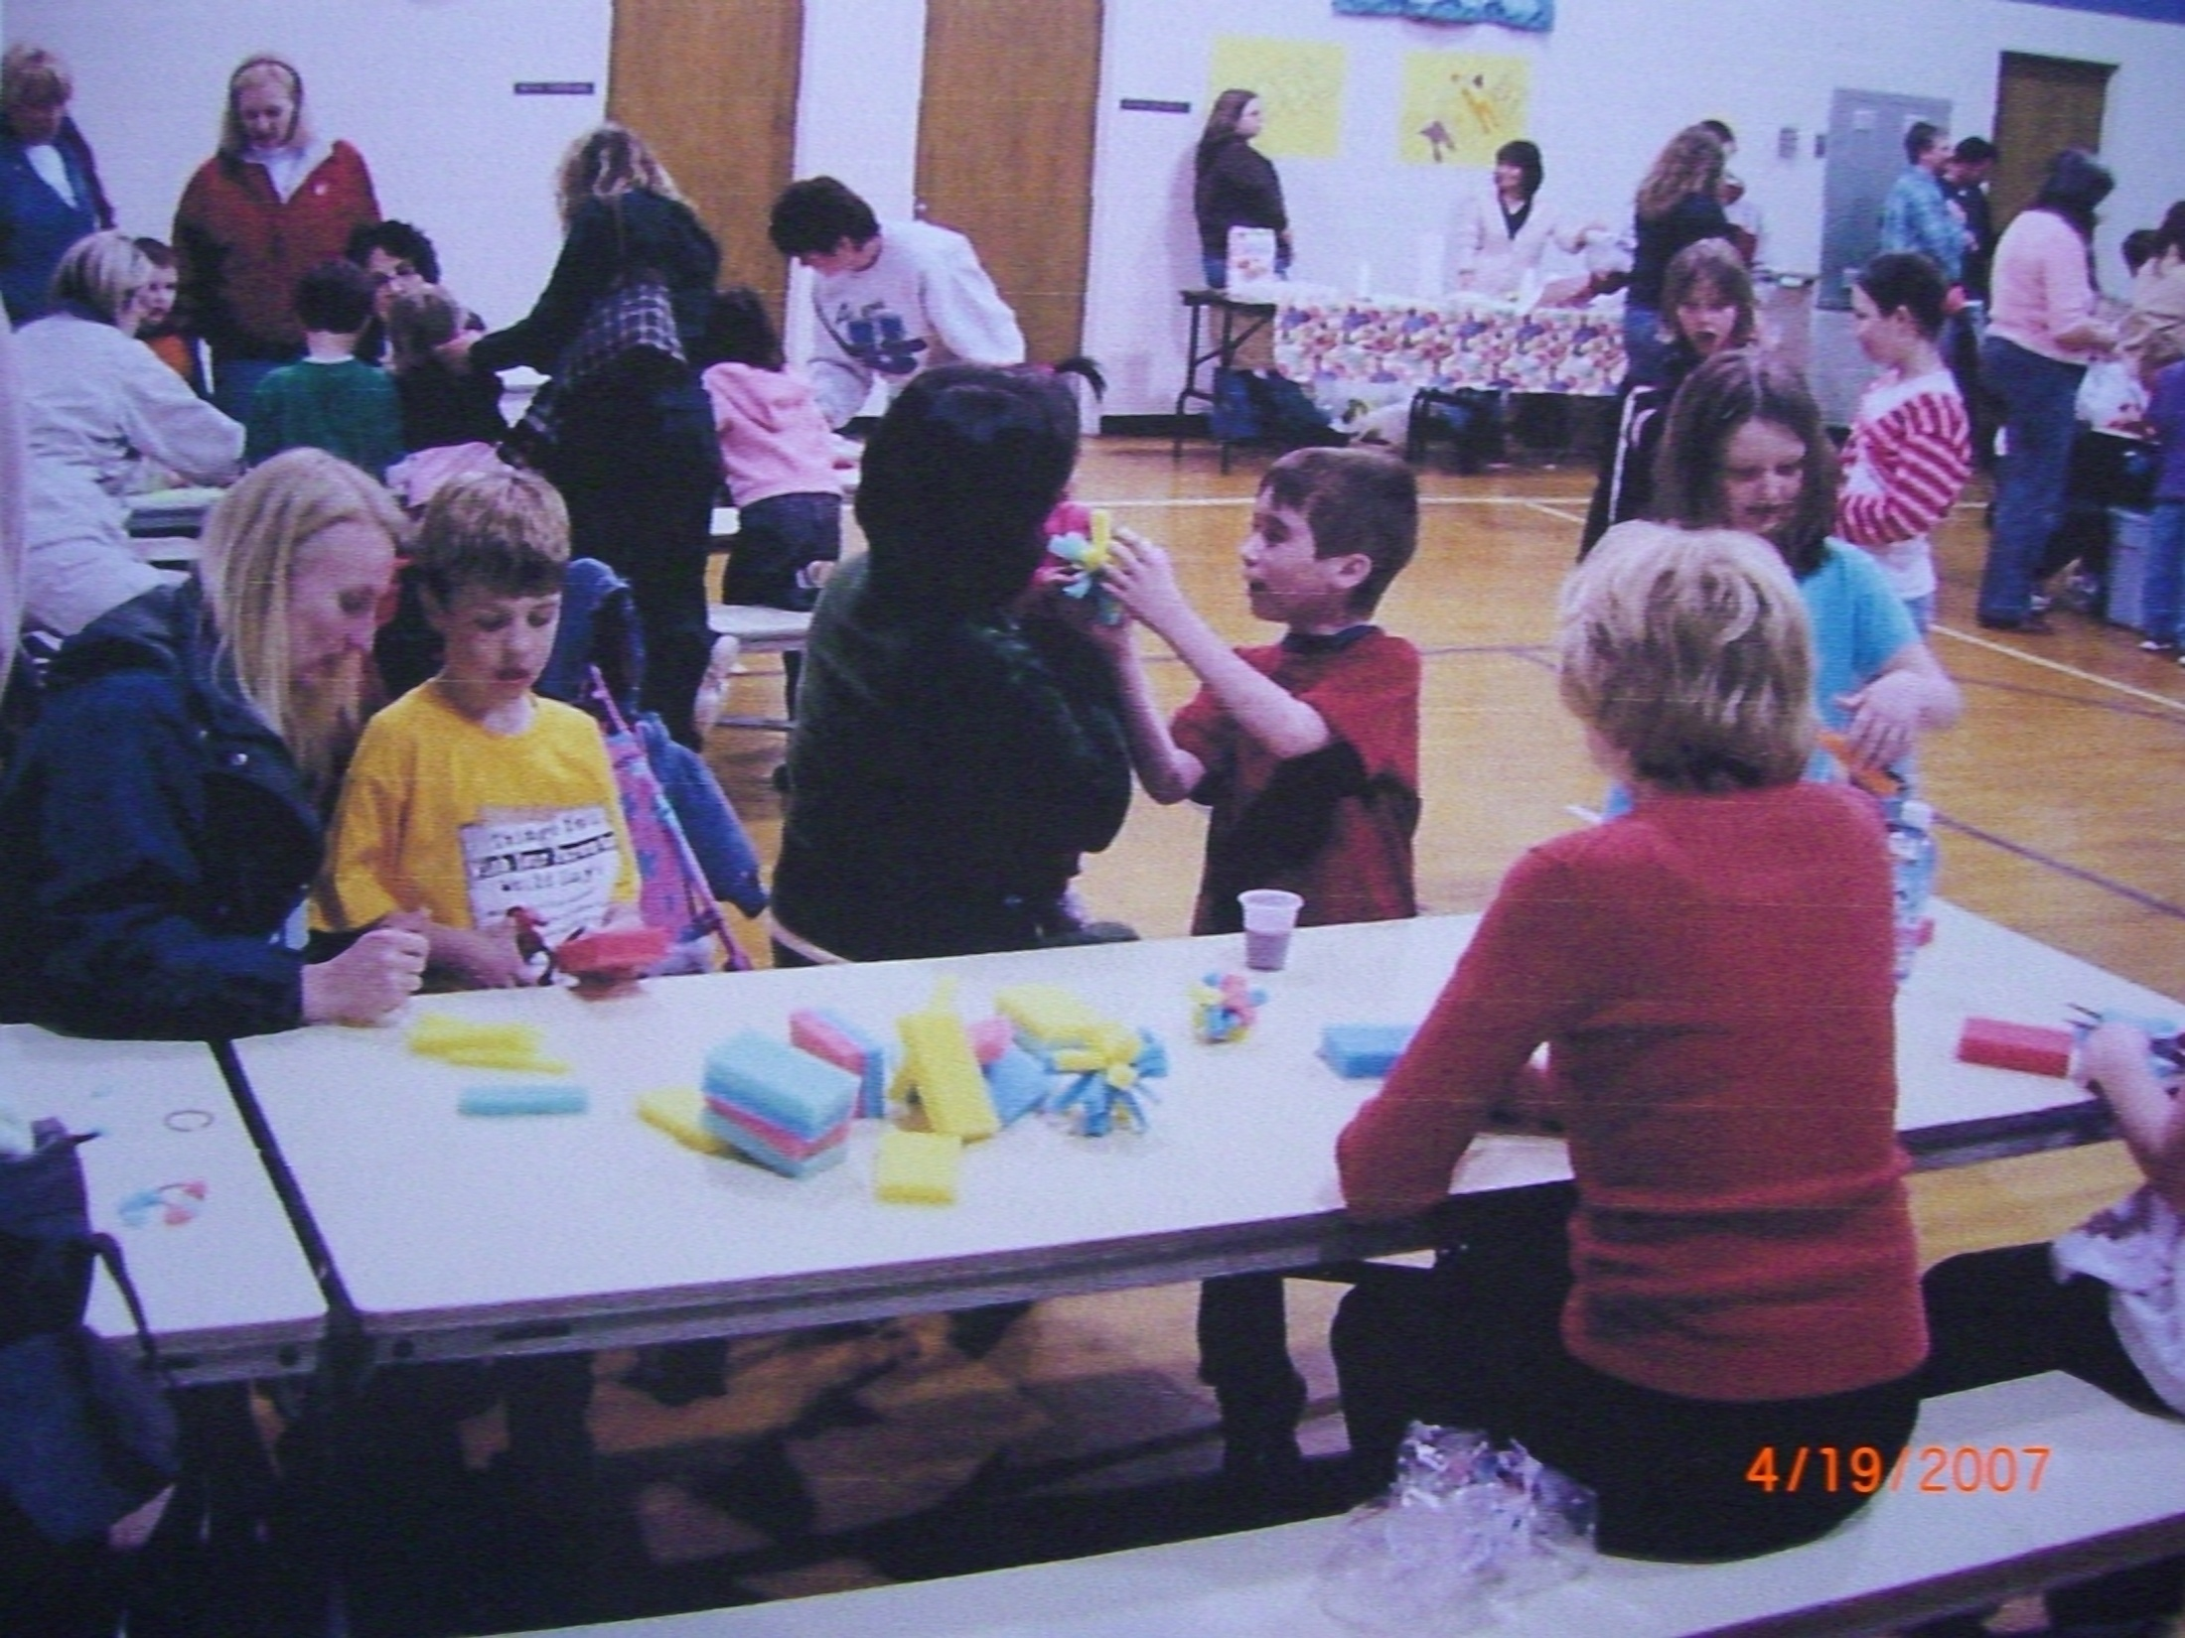

Slide 69
5. Students Educate Others
They write books
They make brochures
Videos
Power Point presentations
Posters
T-Shirts

Slide 70
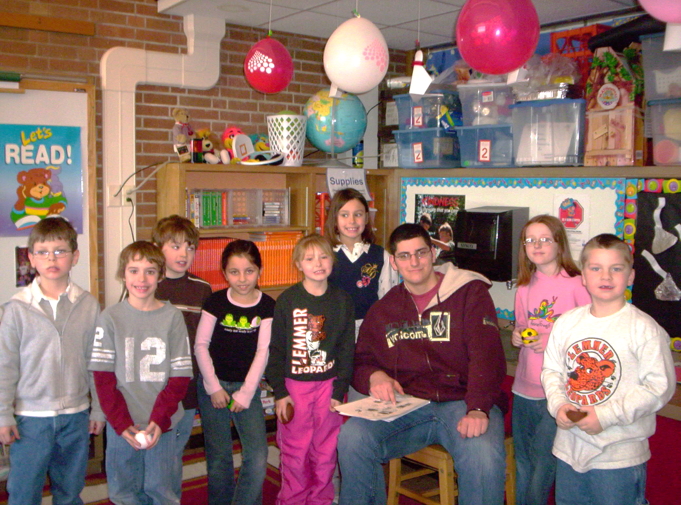
High School students wrote books and gave them to Elementary students.

Slide 71
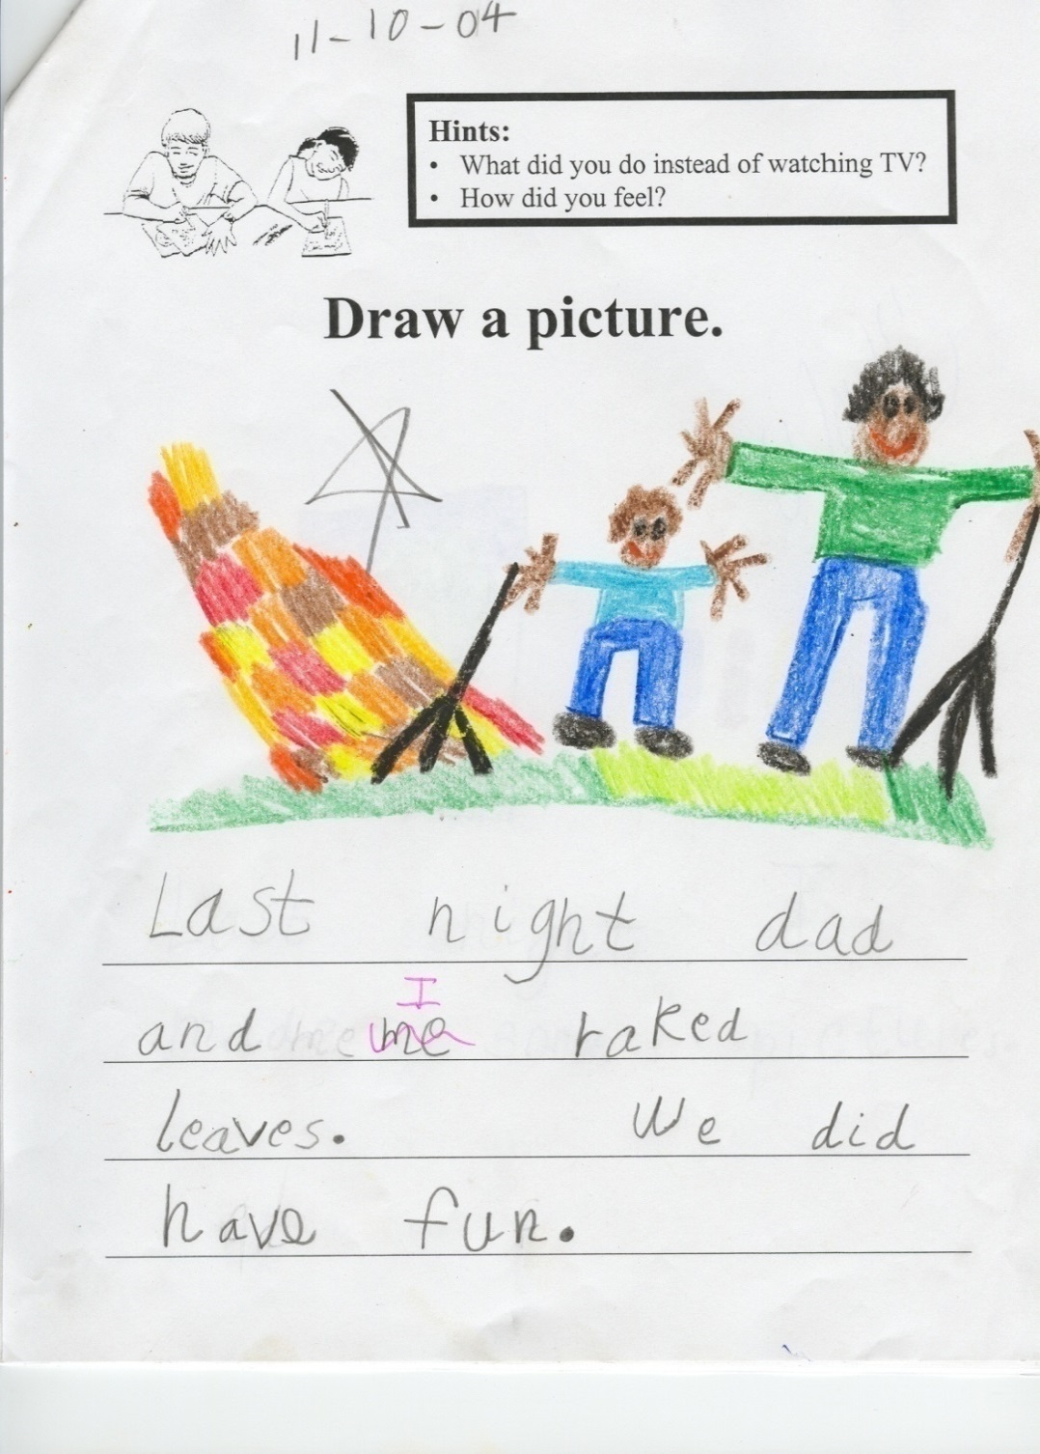

Slide 72
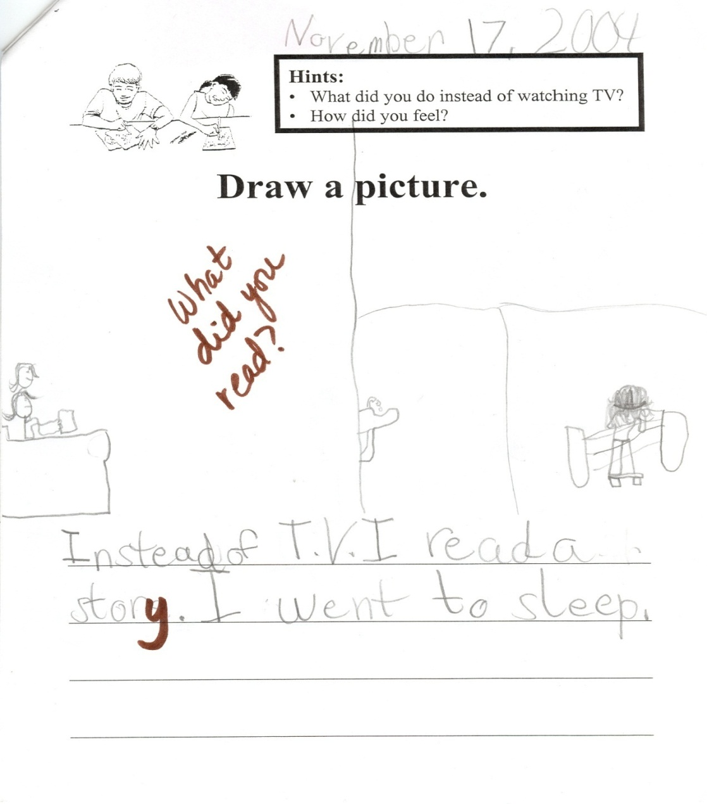

Slide 73
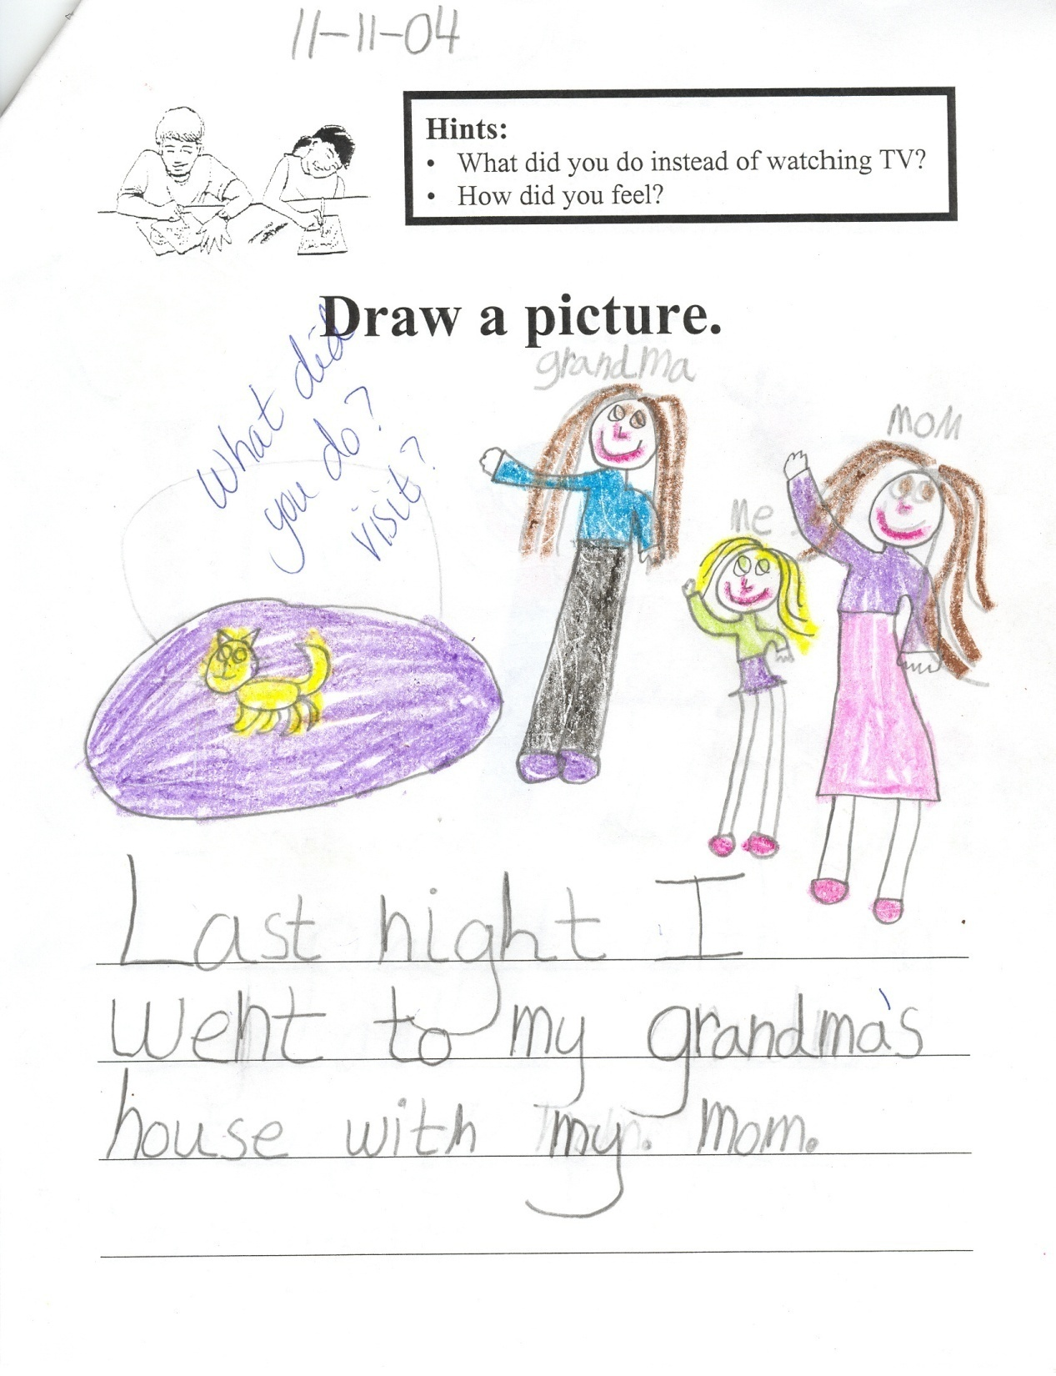

Slide 74
Encourage Parents to:
Step 1. Set Rules and Have a Media Budget (www.aap.org media and children)
Step 2. Keep Media in Family Areas
Step 3. Talk about Content and Eliminate Violent Programming
Step 4. Teach Your Children Media Literacy

Slide 75
To evaluate media for children & teens use G.R.A.M.S. Rules
G – Does it GLORIFY violence?
R – Does it REINFORCE violence?
A – ADD up total entertainment media.
M – Does it MODEL violence?
S – Does it include SOCIAL or relational violence?

Slide 76
Violent Video Game Effects on
Children and Adolescents
“What gives us hope? We found that what happens at home seems to matter. Children whose parents are more involved in setting limits on amount and content of games played, are less aggressive in their day-to-day lives (e.g., getting in fights) . . .
Parents are in a powerful position to minimize negative effects of violent video games by limiting the types of games children play and how much time they may play them.”

Slide 77


Slide 78
Screenagers
Award-winning SCREENAGERS probes into the vulnerable corners of family life, including the director's own, and depicts messy struggles, over social media, video games, academics and internet addiction. Through surprising insights from authors and brain scientists solutions emerge on how we can empower kids to best navigate the digital world.

Slide 79
